Slide 1
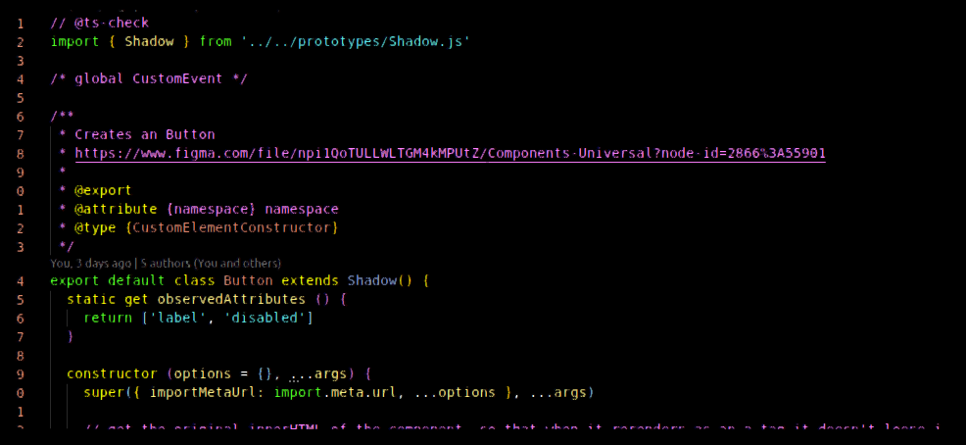


Web Components in action Web Components in der Praxis
CSS and Shadow DOM in Event Driven Web Components as a "no-stack, no-dependency" approach at CMS, SPA, and component library environments.
CSS und Shadow DOM in Event Driven Web Components als «No-Stack, No-Dependency»-Ansatz im Umfeld von CMS, SPA und Komponentenlibrary.

Slide 2



About
Nearly 20 years experience… flash, php, jquery, backbone, typescript, es6 classes, react, angular, vue.js
Migros 6y (met Srdan regarding M4Musics)
Webnesday: HTML5 Game Development 06. November 2019:
😂

Slide 3

What makes a truly independent component?

Slide 4

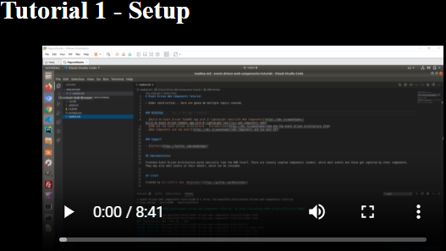
Event Driven Architecture – The journey begins
https://weedshaker.github.io/event-driven-web-components-tutorial
Tutorial 1 - Setup
Tutorial 2 - Make a Web Component
Tutorial 3 - Load a Web Component
Tutorial 4 - Structure and Type-Highlighting
Tutorial 5 - ShadowDom
Tutorial 6 - Routing
Tutorial 7 - Event Driven
Great starting point for folks who haven’t had much experience with Web Components or haven’t been using those in an event driven manner.

Slide 5
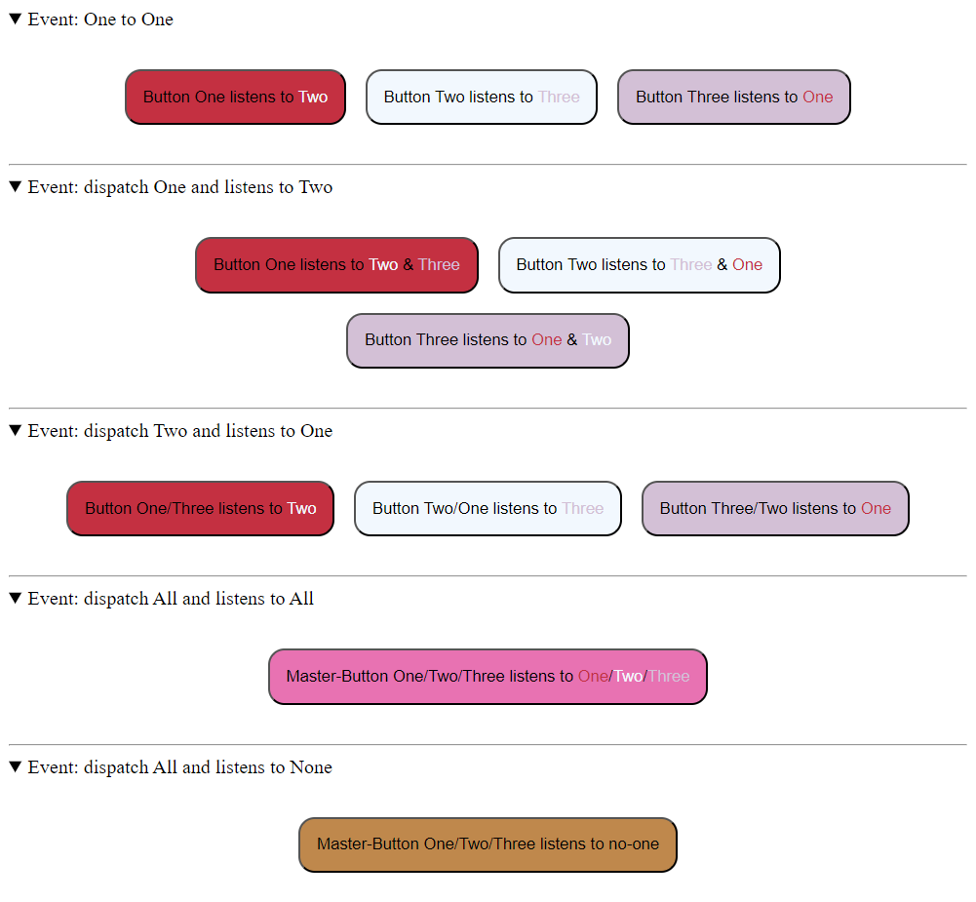


Event Driven Architecture – Easy example
https://github.com/Weedshaker/webnesday2023_event-driven Live Demo: Event Flow, Event Details
ℹ Static

Slide 6
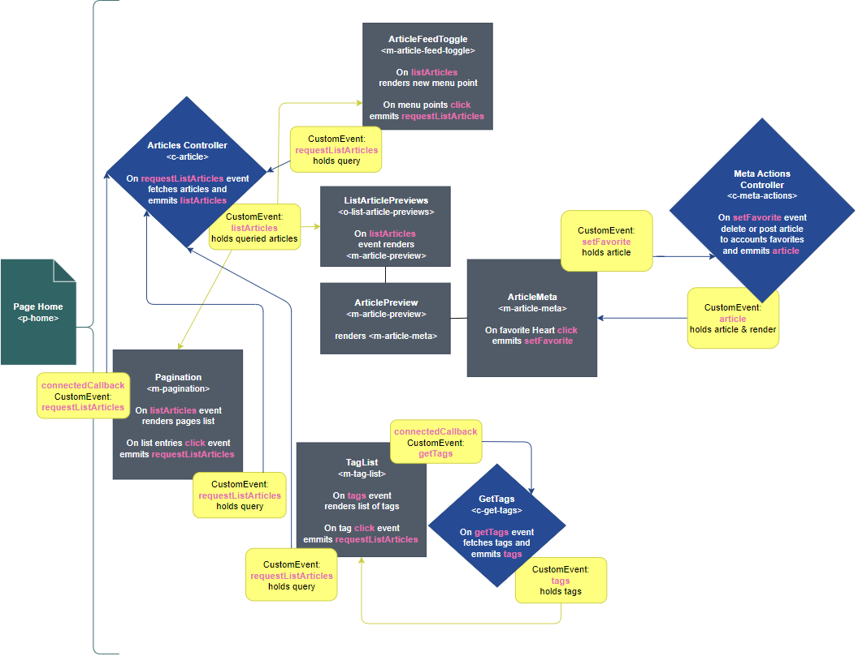

Event Driven Architecture – Complex example
ℹ Headless
https://github.com/mits-gossau/event-driven-web-components-realworld-example-app 👈

Slide 7

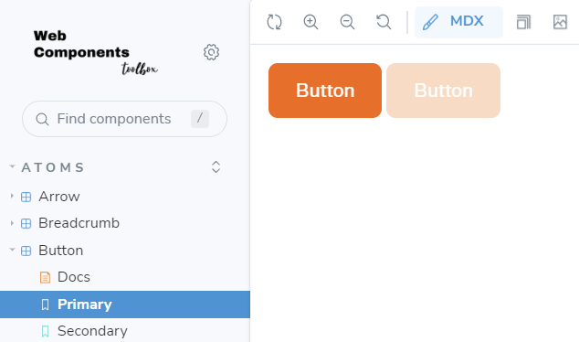

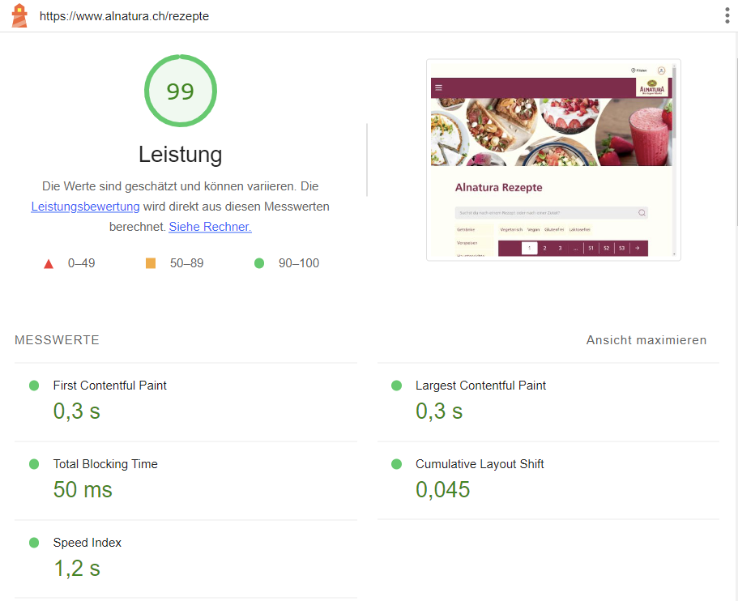

Event Driven Architecture In Action
ℹ Hybrid (Static/Headless)
Alnatura Rezeptfilter 👉 https://www.alnatura.ch/rezepte
SEO: Button becomes link by requesting URL from controller, without fetch: Web Components Toolbox 😎 (mits-gossau.github.io)

Slide 8

Event Driven Architecture – Pros vs. Cons
DOM itself is event driven 👉 Performance
100% Web API compatibility
No state management needed; controllers could do so, for their domain…
Flexible; to break out of app aka. reusable 👉 Exclusive communication through events except for attributes (similar to react props)
Easy to adjust even for fullstacks and backenders 👉 Submodule, no bundler nor transpiler
All async 👉 no blocking
JSDocs Type Annotations
Great error handling and highlighting
-----------------------------------------------------------
Event overview string event names 👈
Event bubbling
Community
No hard architecture guidelines

Slide 9
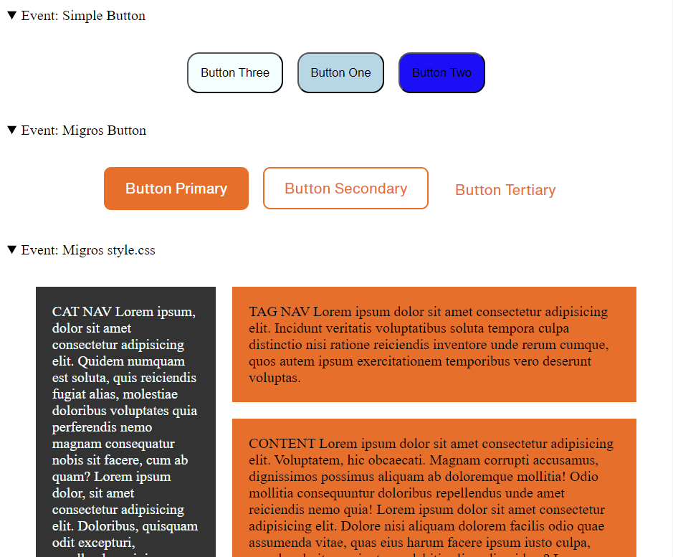
CSS & Shadow-Dom – Example
https://github.com/Weedshaker/webnesday2023_event-driven
Live Demo: Namespace/Theming

Slide 10


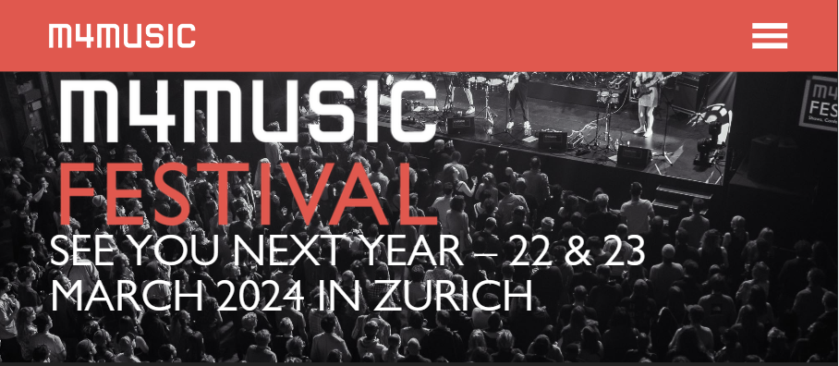
CSS & Shadow Dom In Action
Idee (migros-kulturprozent-classics.ch)
Unsere Brands | Catering Services Migros (betriebsrestaurants-migros.ch)
flexibility / creativity & client capability
m4music Home

Slide 11
CSS & Shadow Dom – Pros vs. Cons
Shadow-DOM encapsulated 👉 CSS rendering performance
100% CSS syntax module level standard
Theming at CSS variable files, inline style tags with variables or through dedicated themes
CSS in JS, CSS at dedicated themes
Flexible; to break out of app aka. reusable 👉 Style encapsulated in both ways (in & out)
Easy to adjust even for fullstacks and backenders 👉 Attributes and/or CSS variables for stylings are pretty straight forward
“!important” statements and other bad practices hurt less when encapsulated
-----------------------------------------------------------
CSS variables overwrite and reassignments
Important tricks regarding appearance :not(:defined) {display: none;} 👈
Browser devtools have bad CSS variables “with fallback” highlighting

Slide 12

Shadow.js, other prototypes and the wc-config.js
web-components-toolbox/src/es/components/prototypes at master · mits-gossau/web-components-toolbox · GitHub

Slide 13


What makes a truly independent component?
Independency of brain (event) and body (style)
-> all thanks to regex-namespace-theming and events
No Framework but Library with pure Standard ECMA Script aka. es6 aka. Vanilla JavaScript
Zero dependency
-> Futureprove

Slide 14
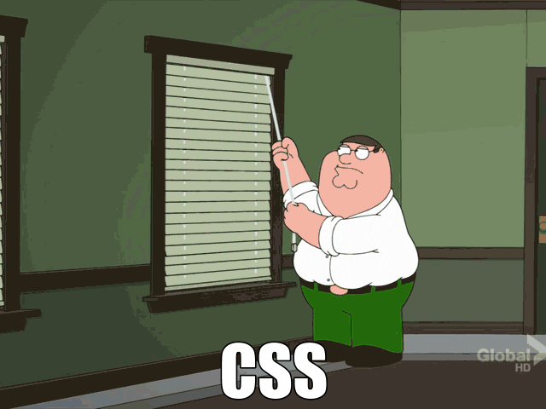
Statement Srdan
ℹ The only CSS related GIF I found 😂

Slide 15

Questions?

Slide 16
THE END

